Slide 1

All Set for
your next trip?

Slide 2
What would be your destination?

Slide 3
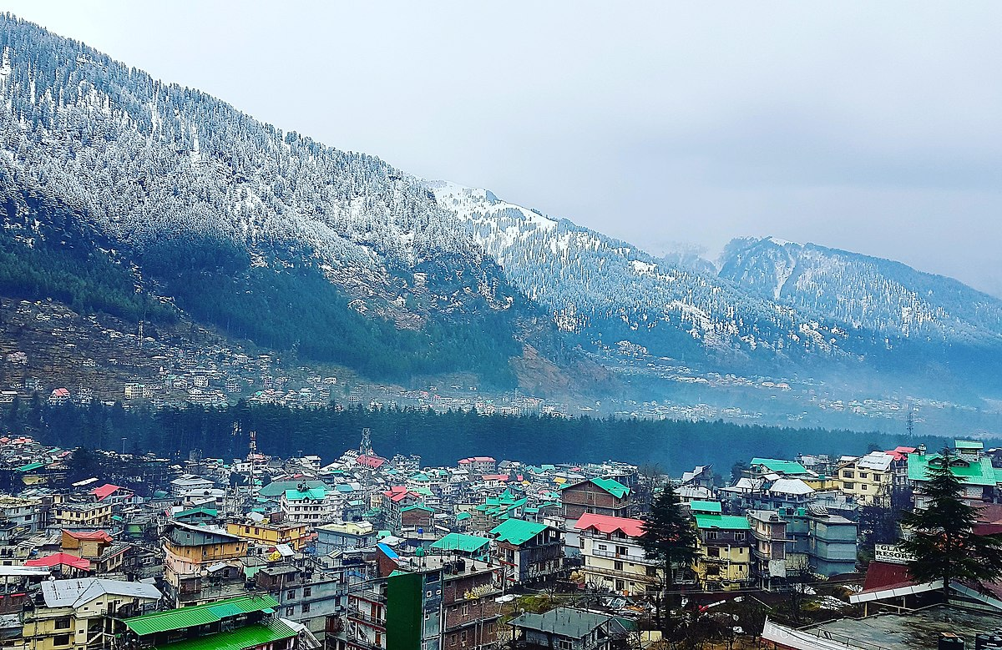

Manali

Slide 4
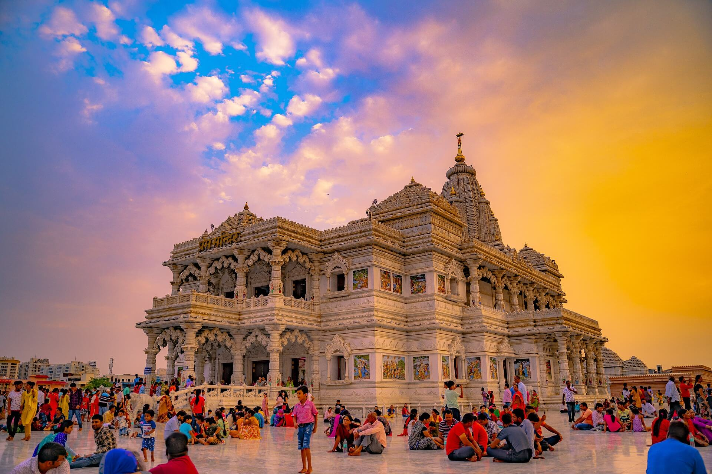
Vrindavan

Slide 5
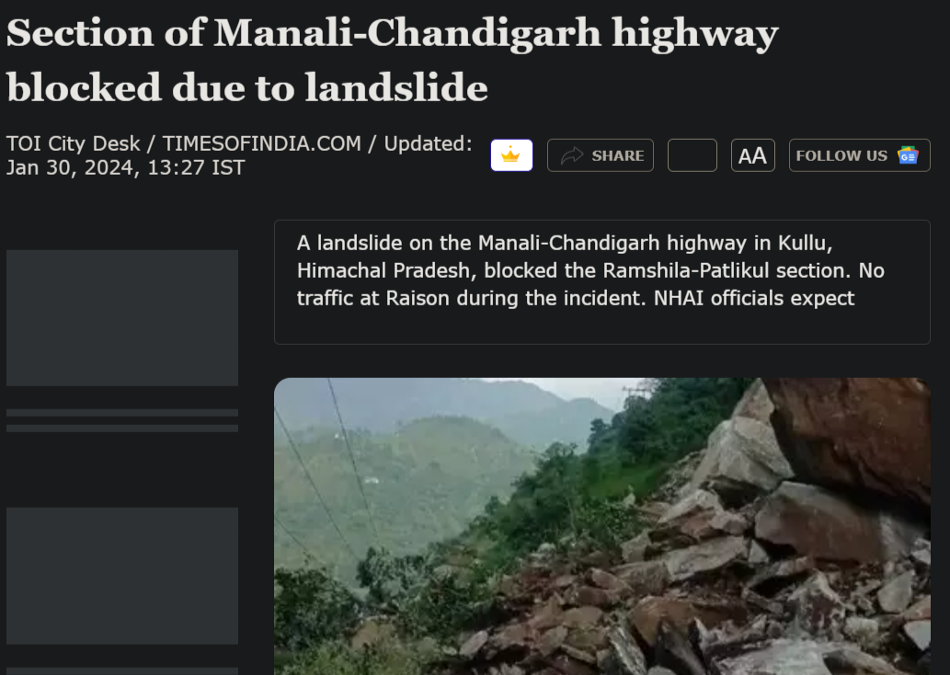
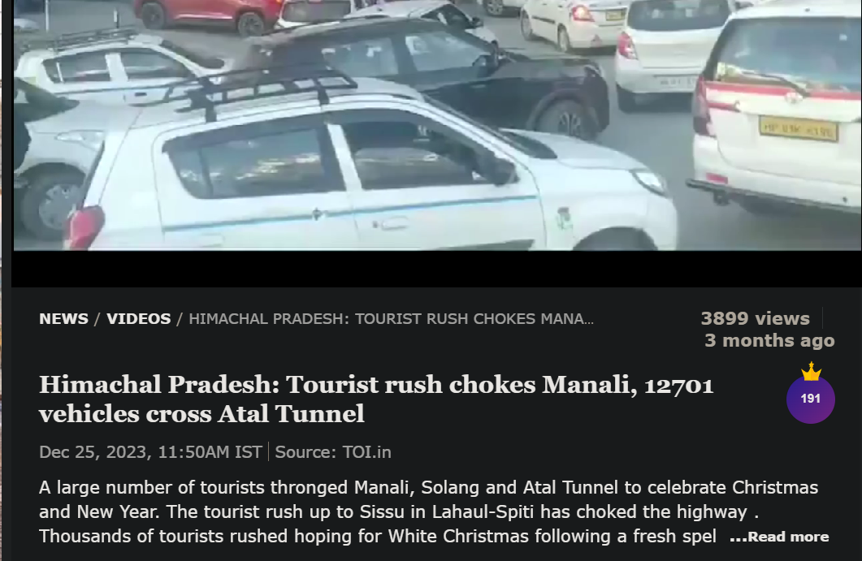
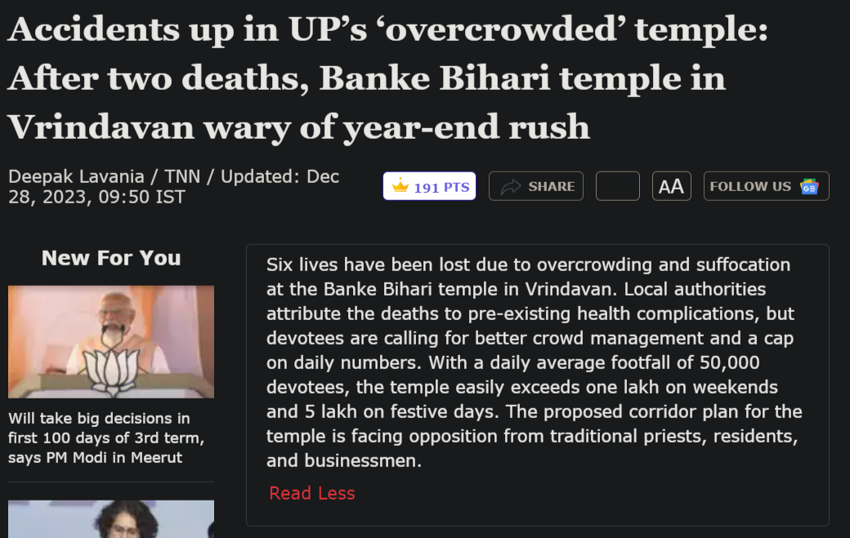
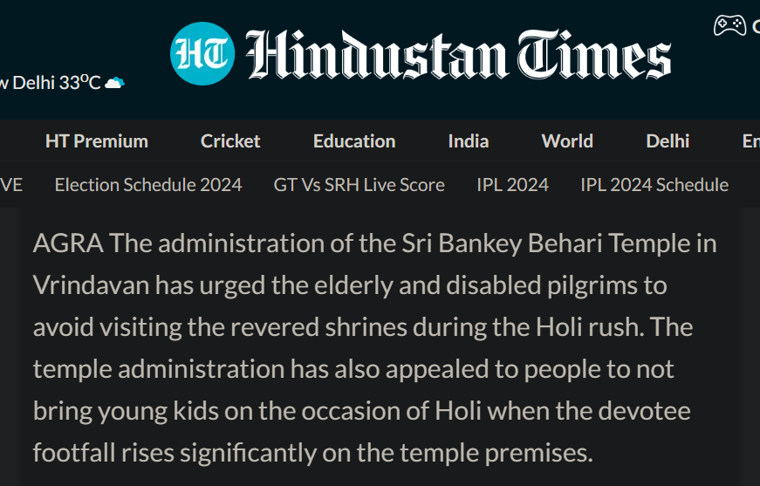
News

Slide 6
Trip Pulse
Group 35
Empowering Safe Journeys with Personalized Travel Safety Alerts

Slide 7
TABLE OF CONTENTS
01
02
03
04
05
06
Problem Statement
Literature Review
Defining the problem faced while travelling.
Limitations in the available apps and research in the market
Proposed Solution
Pipeline
Define our goals and the strategy to solve the problem
The architecture and the flow of computation.
Challenges
Novelty and Goals
Limitations and challenges in our system.
Our leverage with the solution and goals.

Slide 8
01
Problem Statement
Despite the abundance of travel websites offering recommendations on destinations, there remains a critical gap in providing comprehensive safety information for travelers.
Current platforms fail to address vital concerns such as the safety status, current situations, and crime rates at destinations. This lack of real-time safety updates undermines travelers' ability to make informed decisions and poses potential risks to their well-being.

Slide 9
02
02
Literature Review
Literature Review
1
1
The Role of Social Media in Health Safety Evaluation of a Tourism Destination throughout the Travel Planning Process
This paper identifies that travelers rely on social media for real-time information, reviews, and recommendations regarding health safety measures, such as COVID-19 protocols, to plan for the destinations they intend to visit.
Limitations: Credibility of Information, Temporal Relevance, Sample Bias

Slide 10
02
02
Literature Review
Literature Review
2
Smart Traveler Enrollment Program (STEP)
STEP is a platform provided by the U.S. Department, offering up-to-date safety and security information for travelers. The app subscribes users to receive notifications on relevant travel advisories, helping them stay informed about potential risks and hazards at their destinations.
Limitations: The advisories are subjective to US Govt’s geo-political relations with other countries so it often involves the advisories that may be put to affect the tourism of the other country due to political leverages.

Slide 11
02
02
Literature Review
Literature Review
3
Rethinking Sentiment Analysis in the News
Traditionally, sentiment analysis has been focused on highly subjective text types with clearly defined and unique targets. The emphasis is on the importance of defining targets and separating positive and negative sentiment from news content. The study highlights the challenges and advancements in sentiment analysis within the news domain.
Limitations: The available models of sentiment analysis of news headlines like (bertweet-base-sentiment-analysis) are not from the perspective of a tourist.

Slide 12
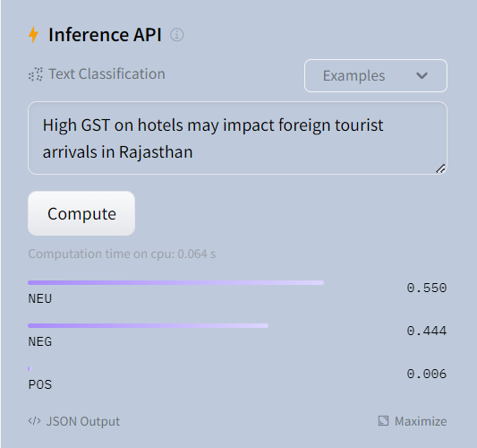
02
02
Literature Review
Literature Review
3
Rethinking Sentiment
Analysis in the News

Slide 13
02
03
Proposed Solution
Real-time news
Real-time weather info.
Fetching real time news of the destination city/state.
Fetching real-time whether information to match the user’s preference.
Ticket Price History
Events & Happenings
Identifying the average price history of railway and airways (optional)
Events and happenings around the city via scraping on BMS

Slide 14
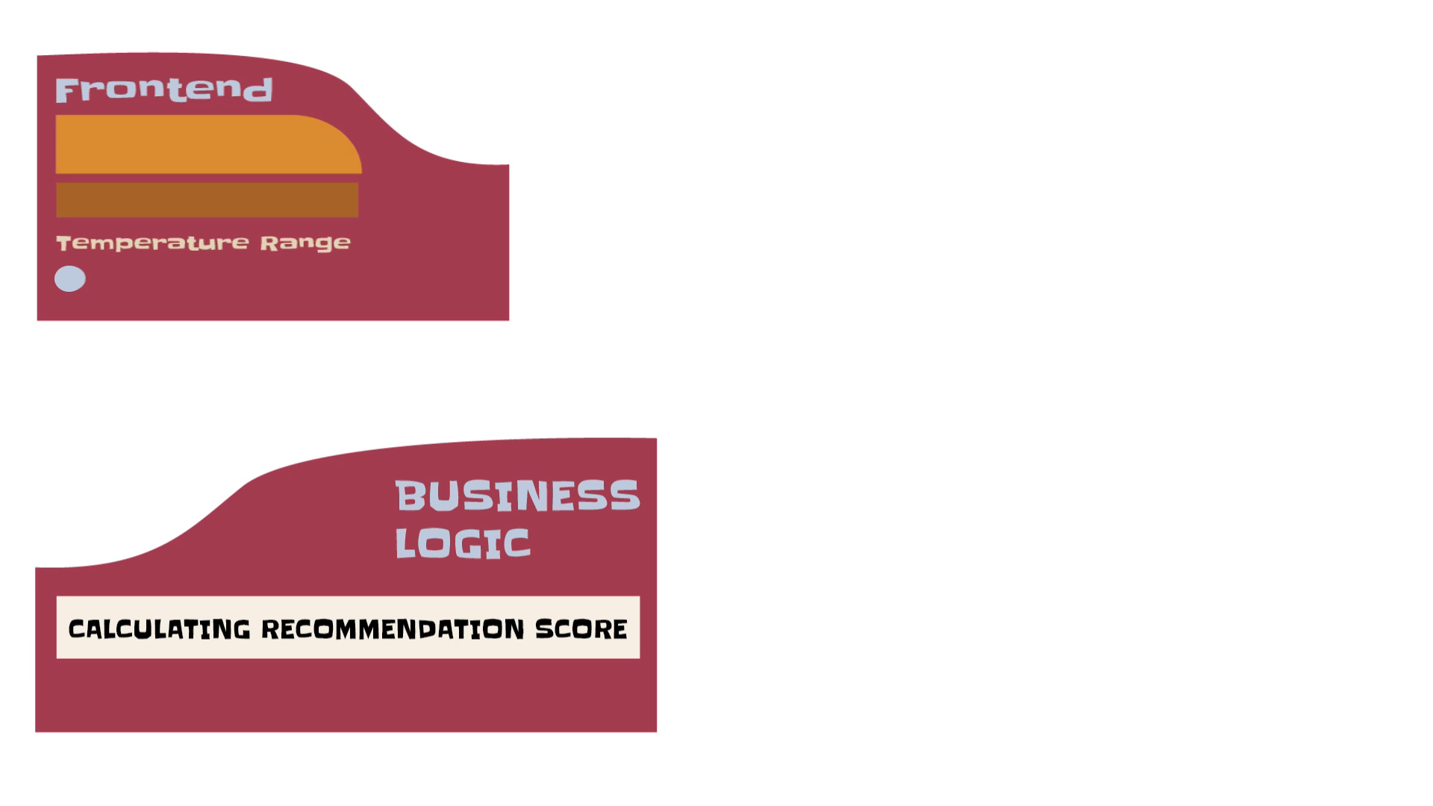
Pipeline

Slide 15
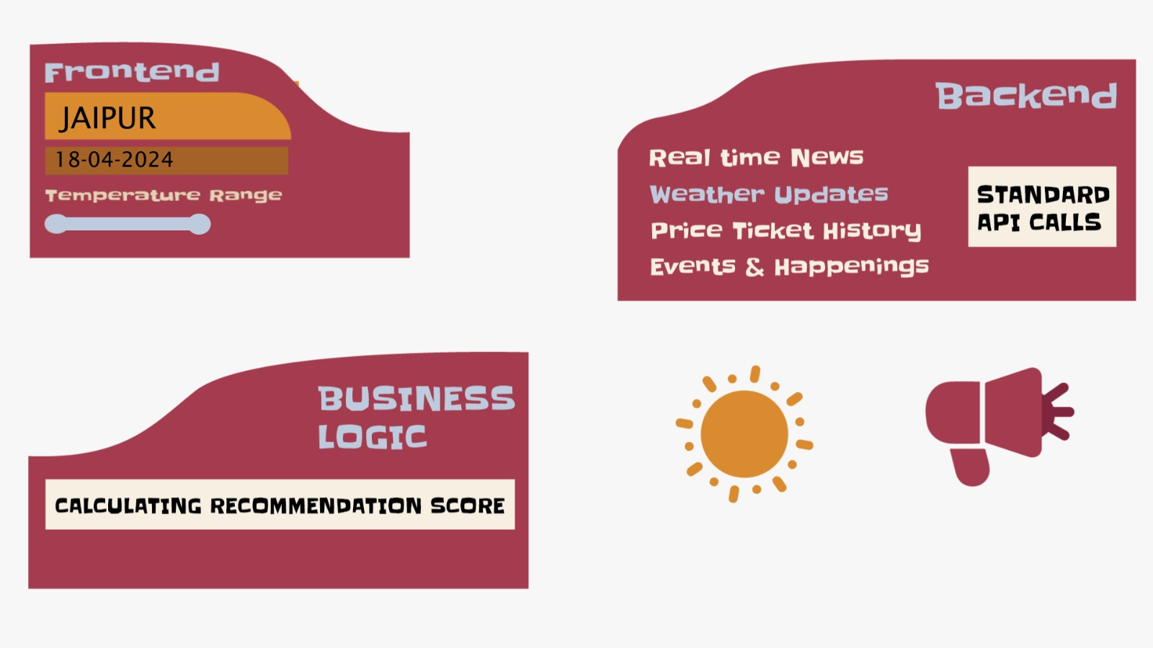
Pipeline
Sentiment Analysis
ML-Model

Slide 16
Novelty
Sentiment Analysis of news articles from the travelers viewpoint
Prioritise safety perspective of destinations
Personalised insights to guide during trip planning

Slide 17
GOALS
Short term (6-12 mon)
Med term (1-2 years)
Fine-tune existing sentiment analysis model to reflect travelers' perspective.
Integrate scraping of hotel and ticket pricing data to provide users with insights into accommodation and transportation costs.
Expand into new markets or geographies
Establish strategic partnerships with travel industry stakeholders, including airlines, hotels, tour operators, and local businesses, to offer seamless booking, reservation, and itinerary planning services.
Long term (3-5 years)
Integrate with travel ecosystems, digital platforms, and smart devices (IoT) to provide holistic travel solutions, personalized recommendations, and real-time updates across multiple channels.
Integrate AR and VR technologies into the recommendation platform to offer immersive previews of travel destinations, accommodations, and experiences.

Slide 18
QnA
Big numbers catch your audience’s attention

